Slide 1
Bannister, S., et al. (2022). Neonatal BCG vaccination is associated with a long-term DNA methylation signature in circulating monocytes. Science advances, 8(31), eabn4002.
Matthew Suderman
MRC Integrative Epidemiology Unit
Sept 12, 2022

Slide 2
Background
Trained immunity (TRIM) “describes the capacity of innate immune cells to develop nonspecific memory characteristics in response to certain exogenous exposures through metabolic and epigenetic reprogramming”
Underlying mechanism is chromatin remodeling initiated by lineage determining transcription factors
Possible example?
Bacille Calmette-Guérin (BCG) vaccine is given at birth to prevent tuberculosis
However, BCG also protective against off-target diseases as well, e.g. yellow fever, malaria, some respiratory tract infections
BCG vaccination induces long-term expression differences in hematopoietic stem cells also observed in peripheral monocytes
Infection of monocytes from vaccinated individuals induces histone modifications
Hypothesis: BCG induces TRIM.

Slide 3
Overview of analyses
Multi-omic analysis of human monocytes before and after exposure to two strains of BCG
EWAS of monocyte DNA methylation from 63 vaccinated and 67 unvaccinated children aged 12-24 months
Follow-up functional work (A-to-I RNA editing)

Slide 4
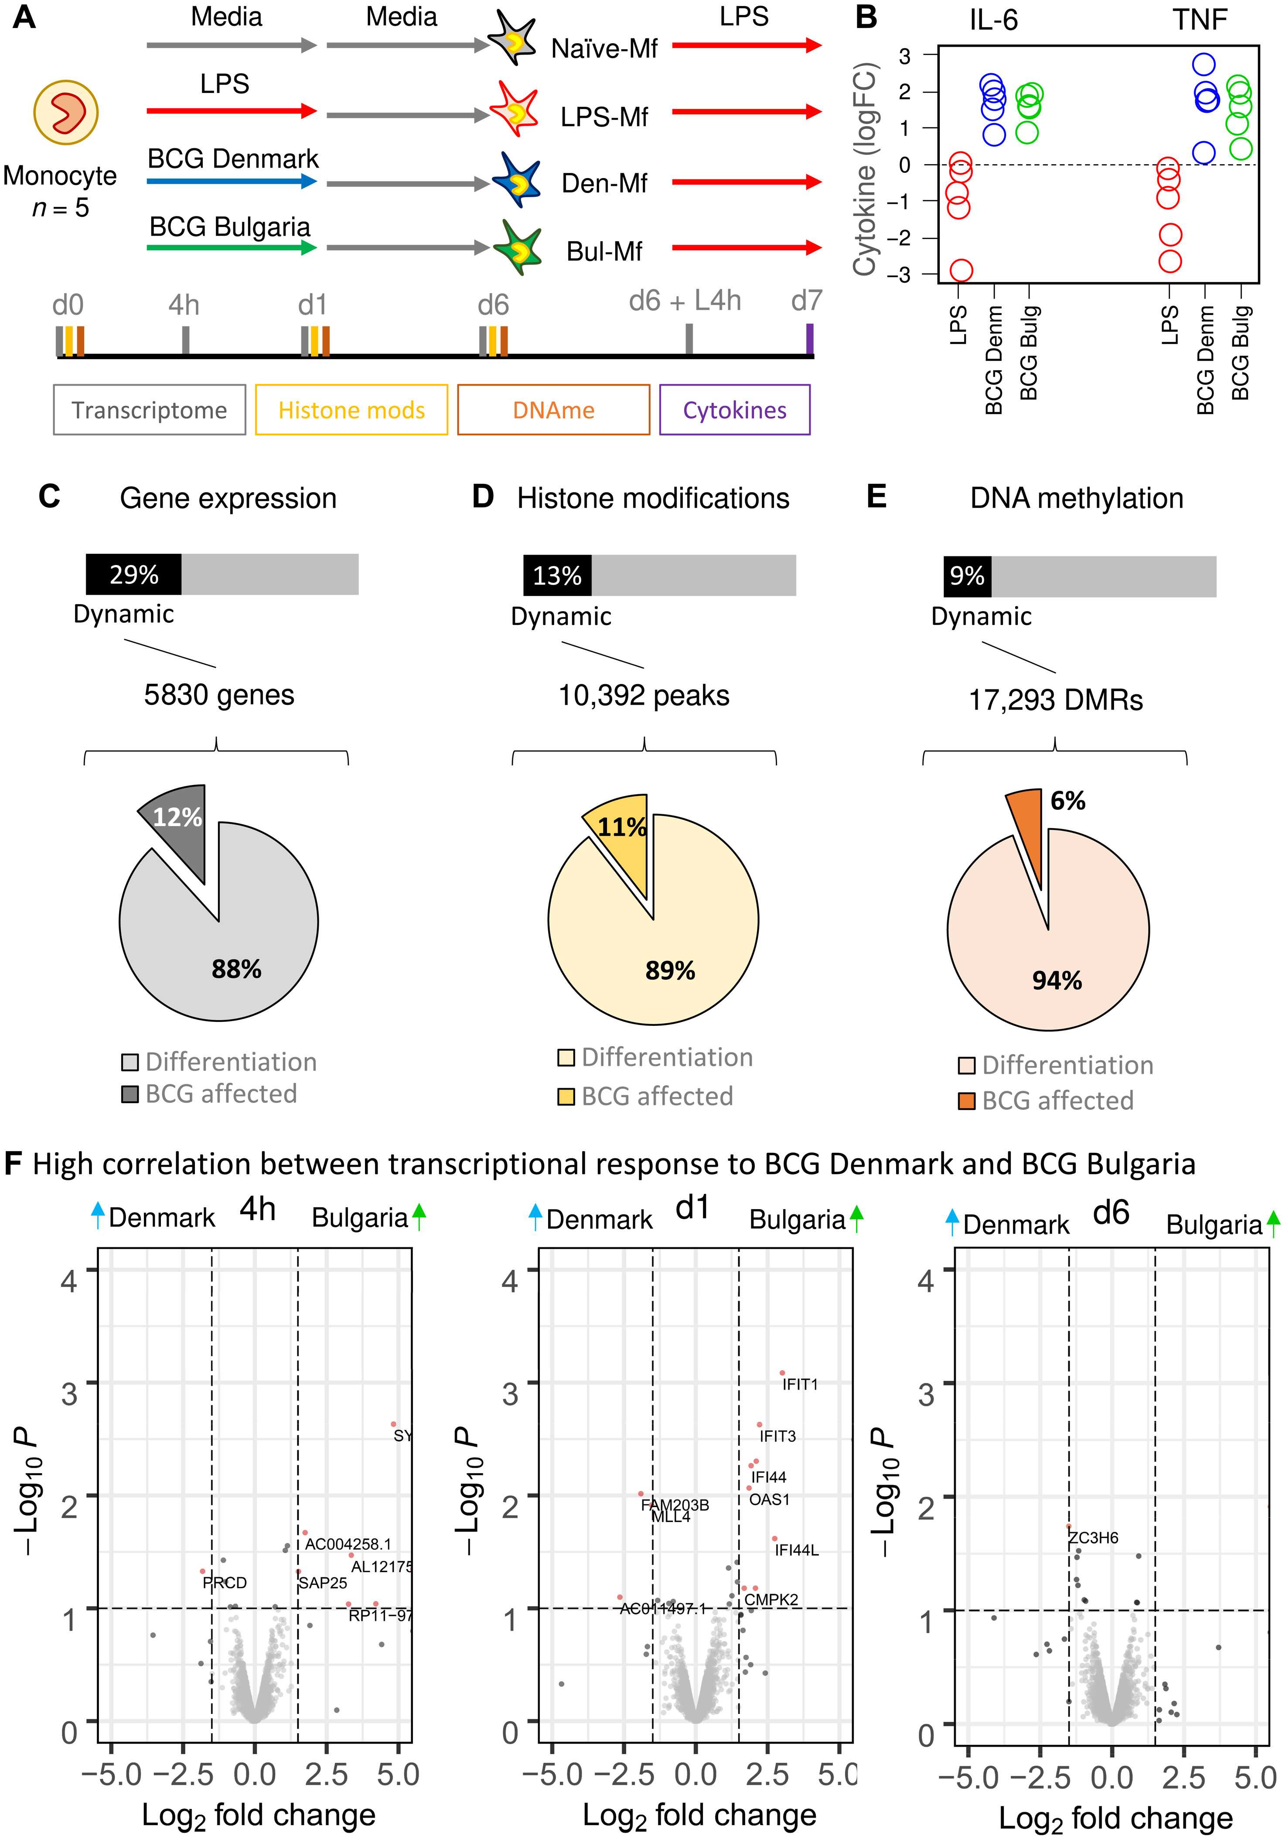
Experimental setup to investigate vaccine response
Experimental setup
Collect human monocytes (d0)
Expose to Media, LPS or BCG (d1)
Expose all to Media (d2-d6)
Lipopolysaccharide (LPS) stimulation (d6)
Note: LPS stimulates immune response in macrophages

Slide 5
Cytokine response is much higher in BCG-exposed cells
Experimental setup

Slide 6
Different BCG vaccines have similar transcriptional effects
Experimental setup
Expression differences between the BCG exposures

Slide 7
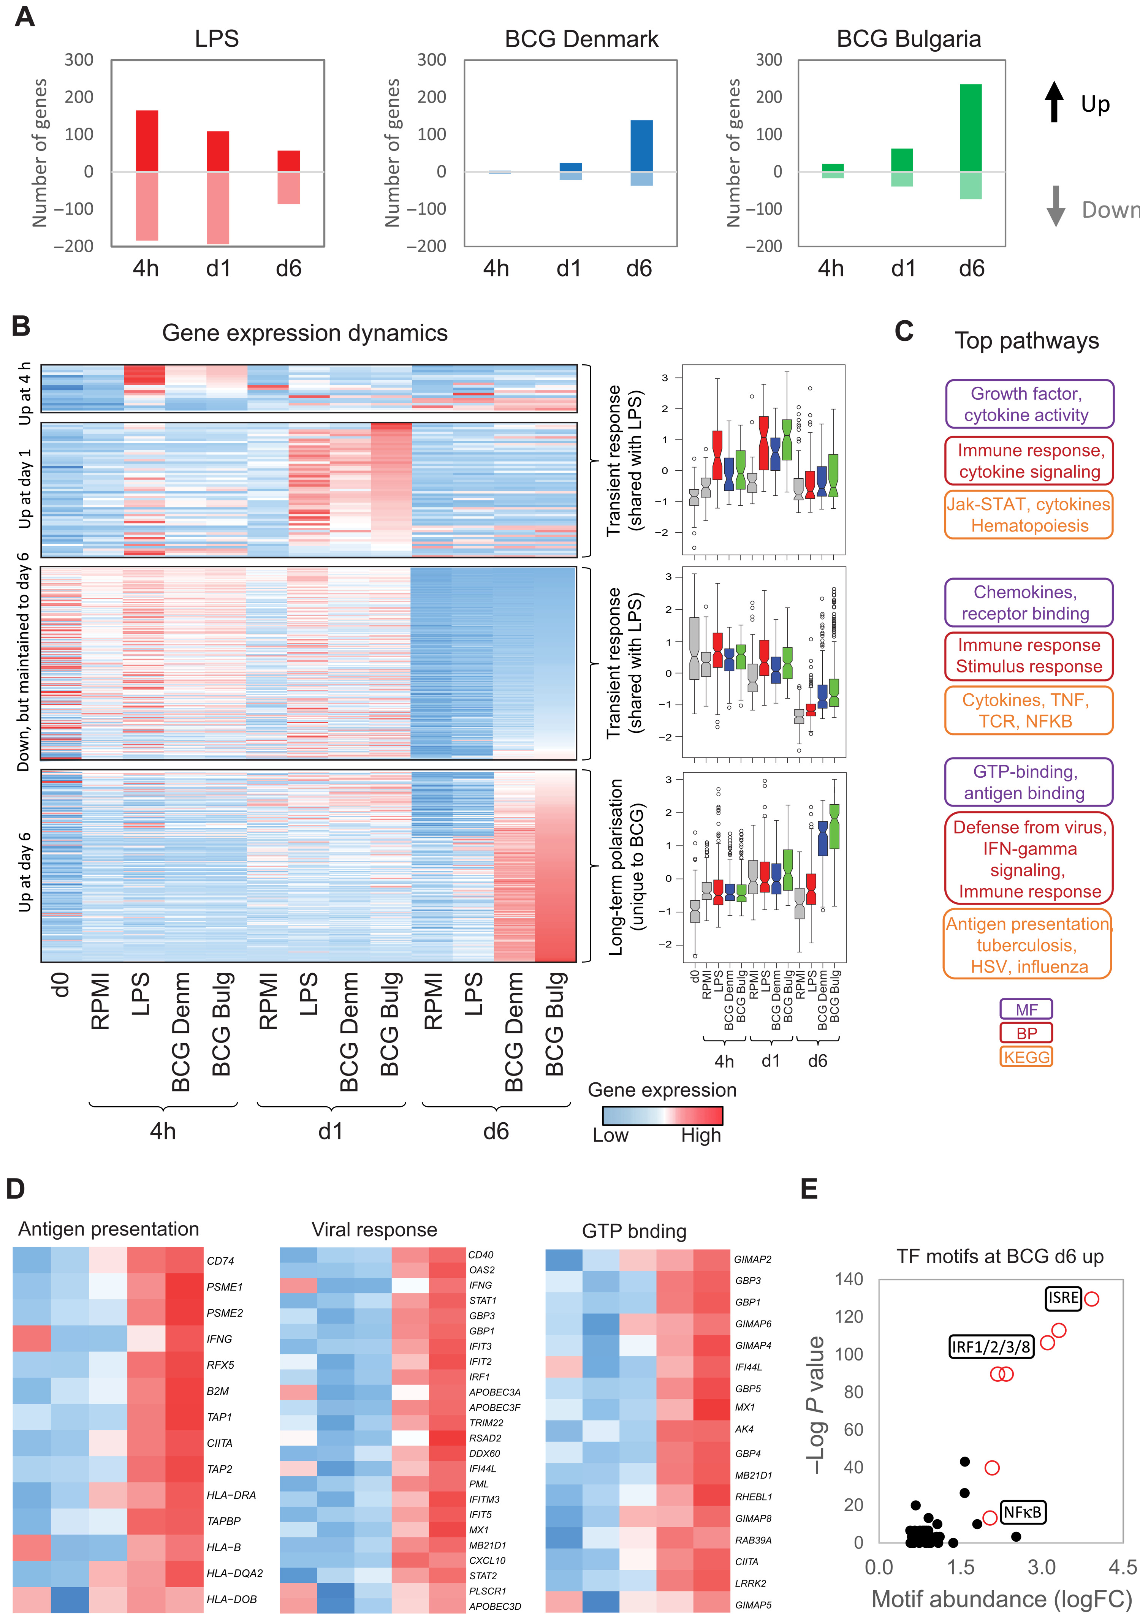
BCG vaccine exposure has a delayed effect on gene expression
Experimental setup
Numbers of genes differentially expressed relative to media-exposed cells at each time point
T

Slide 8
Delayed BCG-specific effect involves genes with viral defense and IFN-gamma signalling functions
Experimental setup
Heatmap shows all genes differentially expressed in either BCG strain over time

Slide 9
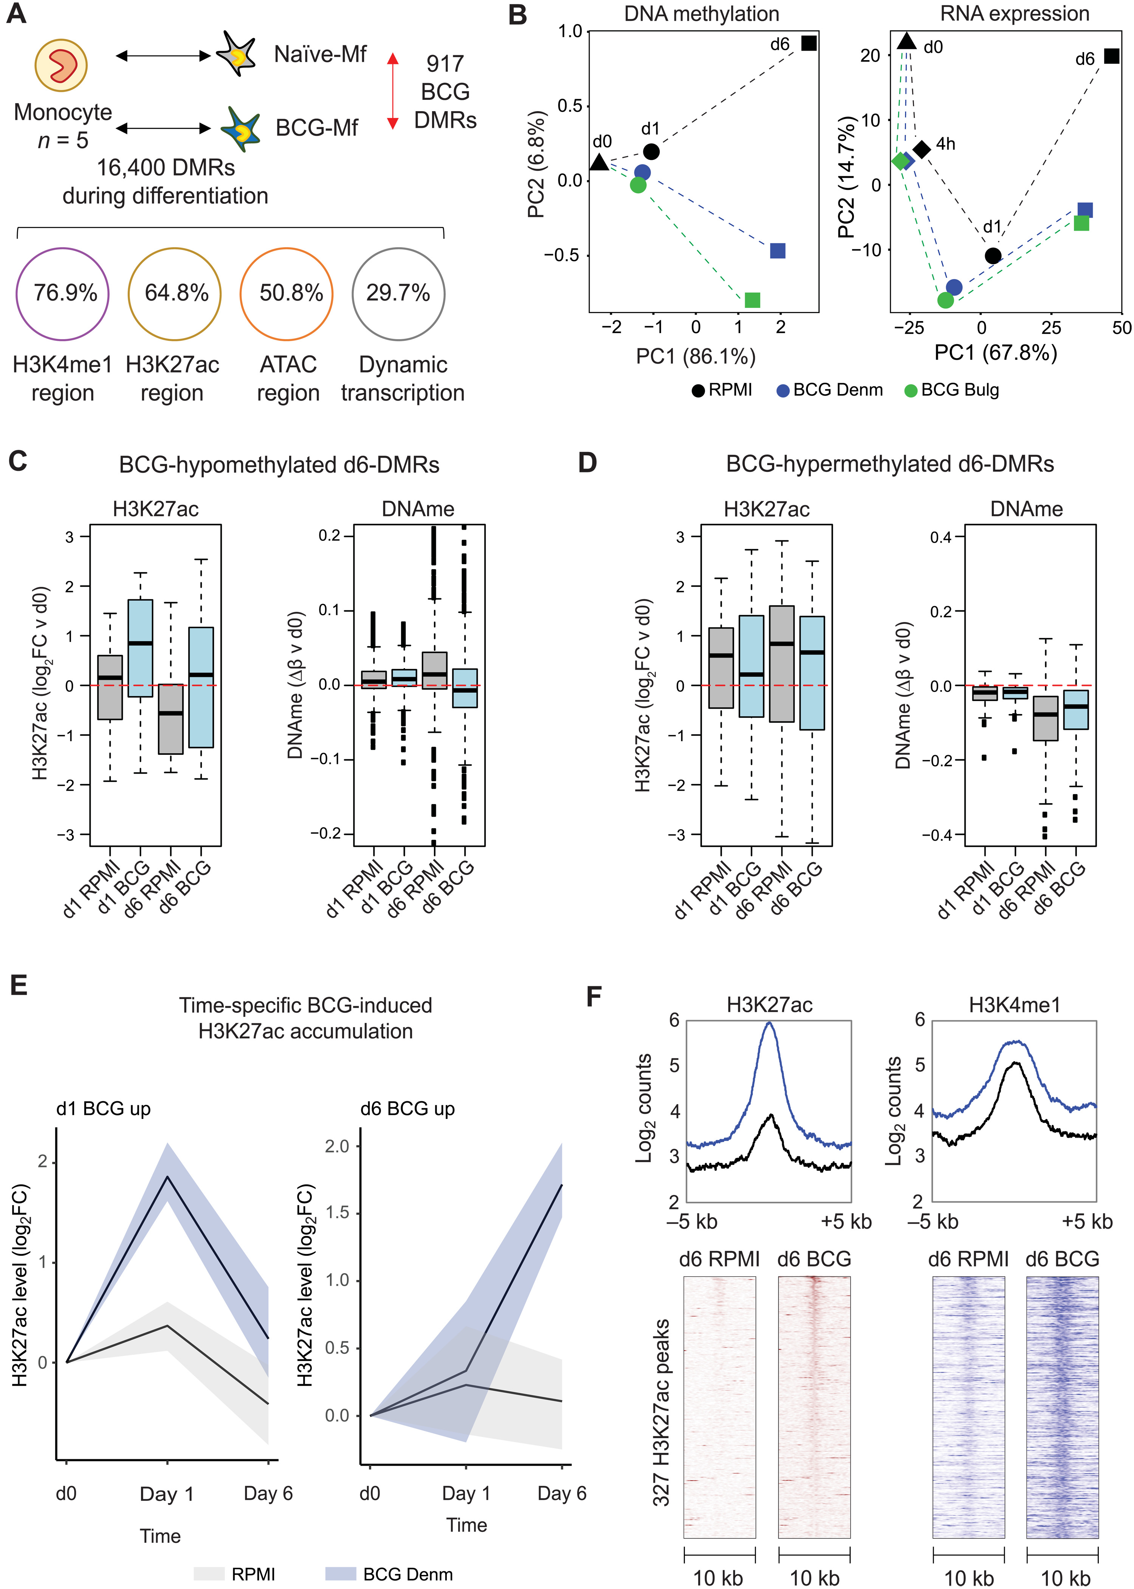
BCG-specific DNAm changes also delayed
Experimental setup
Only 77 BCG-specific DMRs at d1 Vs 917 BCG-specific DMRs at d6

Slide 10
BCG-specific DNAm changes also delayed
and better explained by chromatin states than gene expression
Experimental setup
Only 77 BCG-specific DMRs at d1
Vs 917 BCG-specific DMRs at d6 of which:
5.6% overlap with BCG-specific DEGs
29.7% overlap with DEGs
76.9% overlap with H3K4me1 regions

Slide 11
In fact, chromatin changes predict DNAm changes
Experimental setup
H3K27ac changes in d6 DMRs relative to d0
e.g. BCG H3K27ac in d6 BCG hypomethylated DMRs is already increased at d1 … however, why doesn’t the boxplot for DNAm show reduced DNAm at d6 relative to d1?

Slide 12
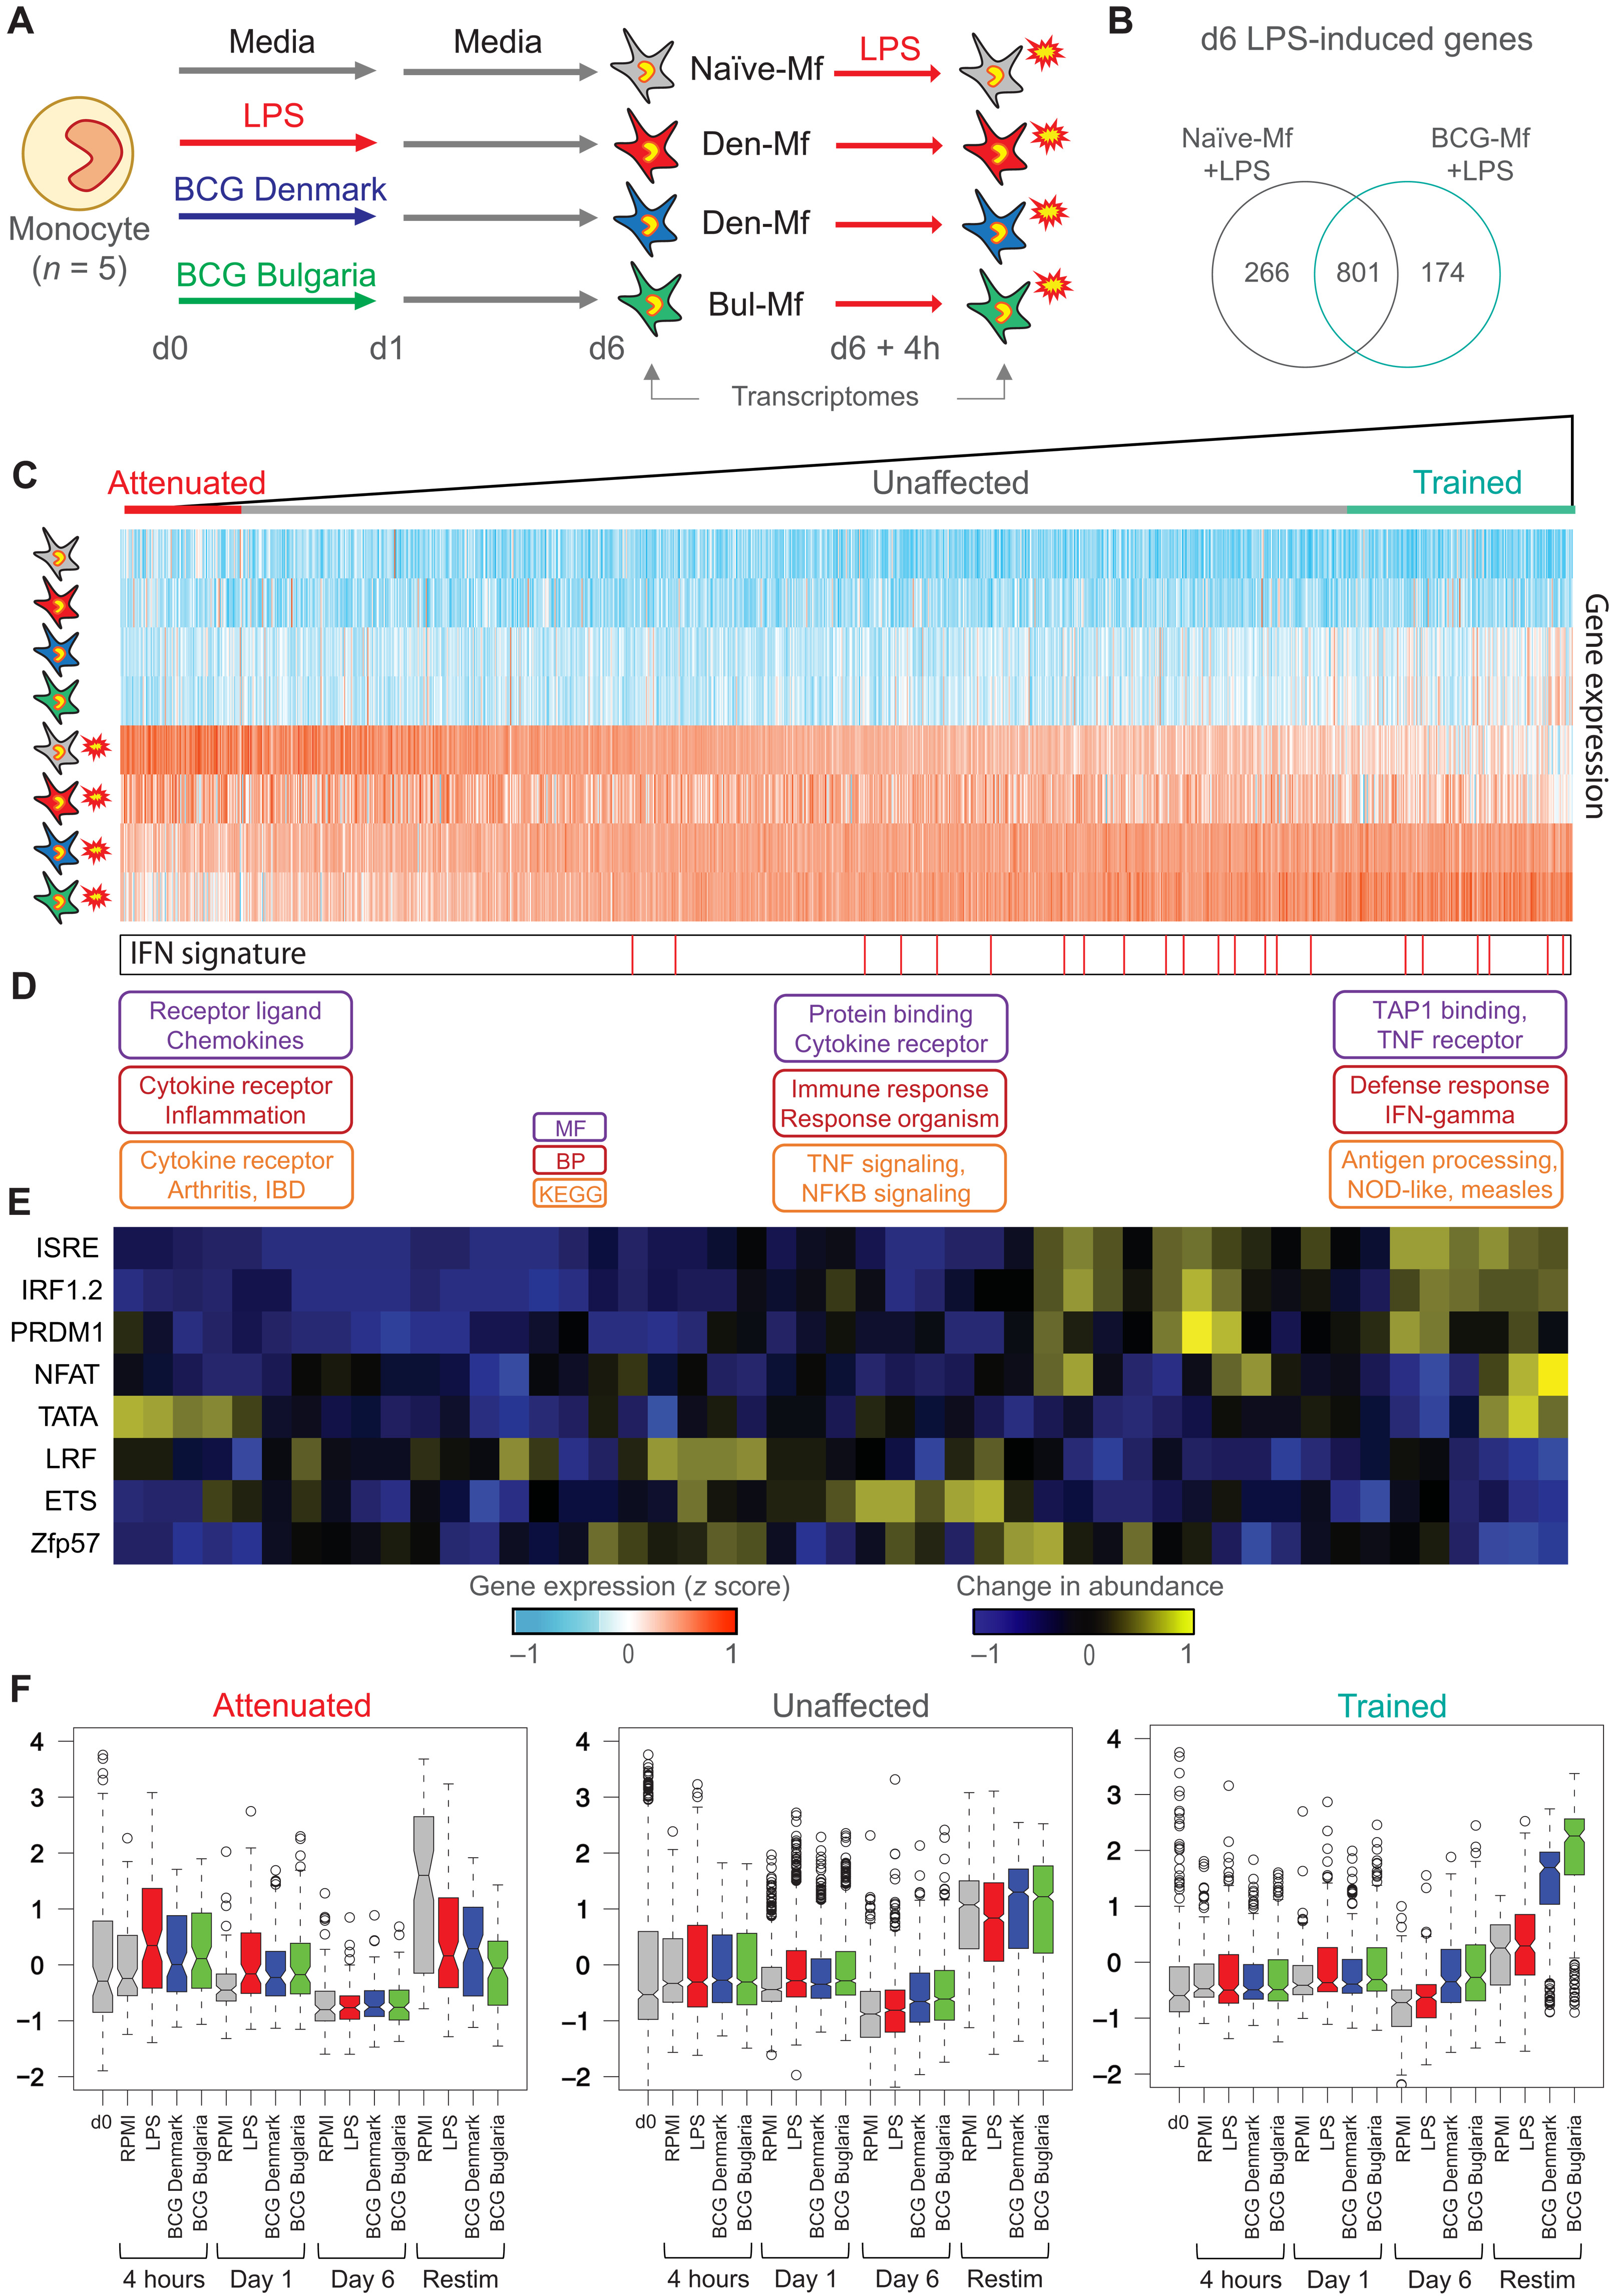
Immune stimulation induces viral transcriptional response in BCG-exposed cells
1242 genes induced by LPS in naïve or BCG-exposed cells Here ordered by similarity of response: Less BCG response … Same response … More BCG response
Experimental setup
Take-away: note enrichment for genes involved in IFN-gamma defense response … we’ve seen this before in BCG-specific transcription

Slide 13
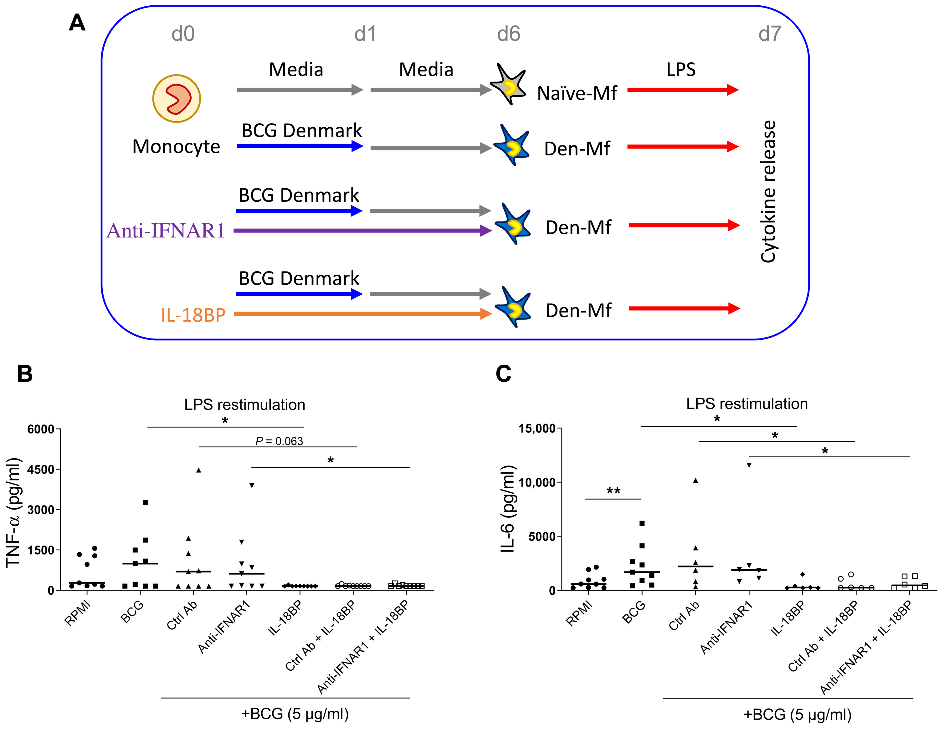
IFNγ is required for BCG-induced TRIM
Experimental setup
Block IFNγ
Block type I IFN signaling
TNFa
IL6
Take-away: IFNγ is required for a TNFa and IL6 immune response

Slide 14
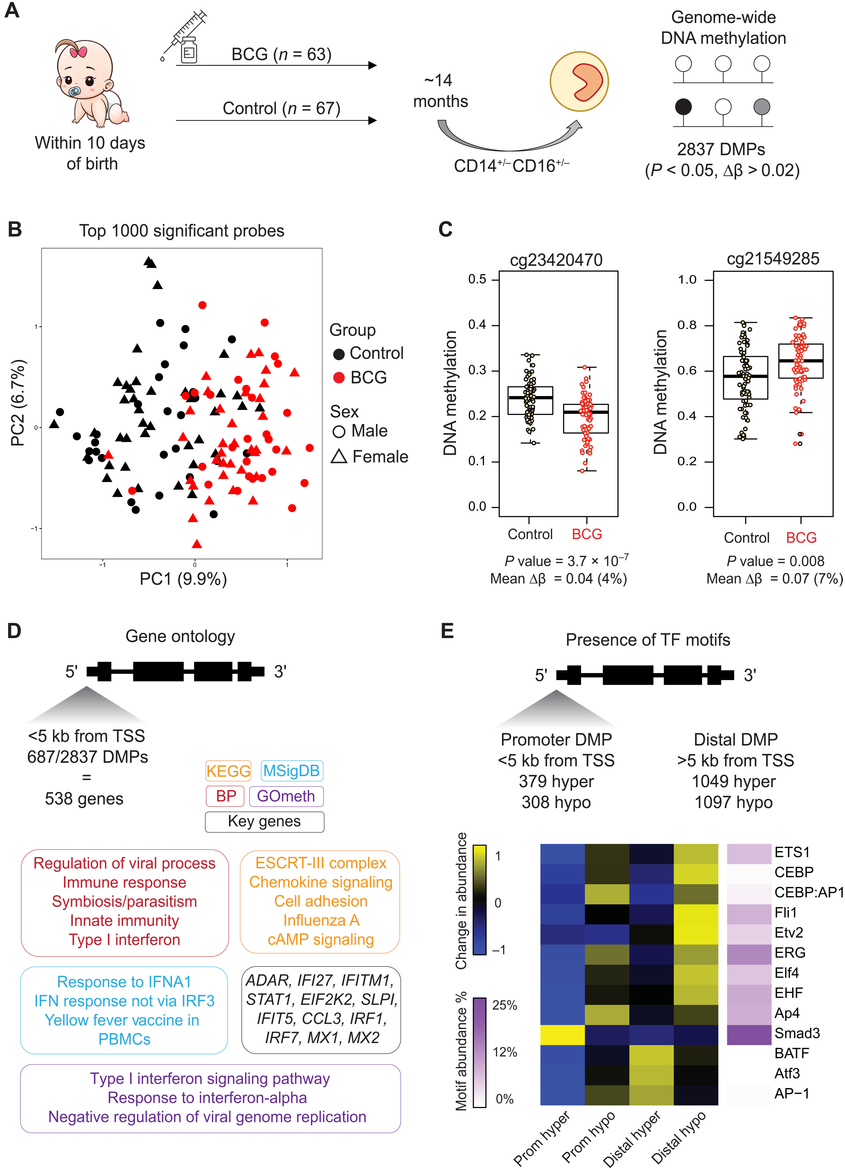
BCG vaccination is associated with a long-term DNA methylation signature in circulating monocytes
Melbourne Infant Study: BCG for the Prevention of Allergy and Infection (MIS BAIR): 63 infants vaccinated at day 10; 67 infants unvaccinated (randomized!)
Monocytes collected at 14 months
EWAS identifies 2837 DMPs

Slide 15
Differentially methylated genes enriched for viral response
e.g.
Regulation of viral process
IFN response
Type I interferon signaling
Regulation of viral replication

Slide 16
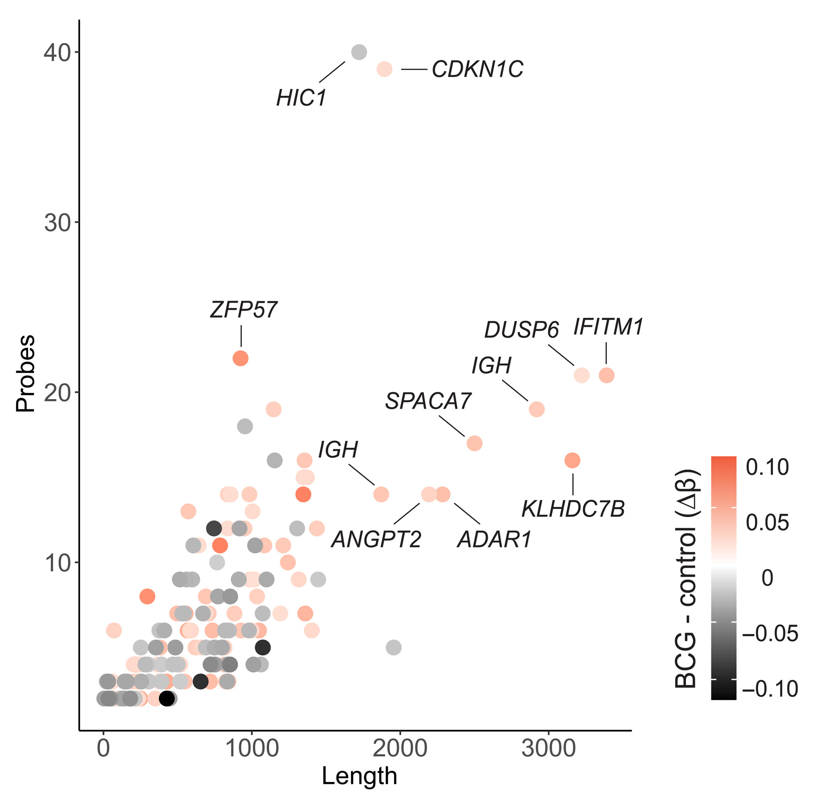
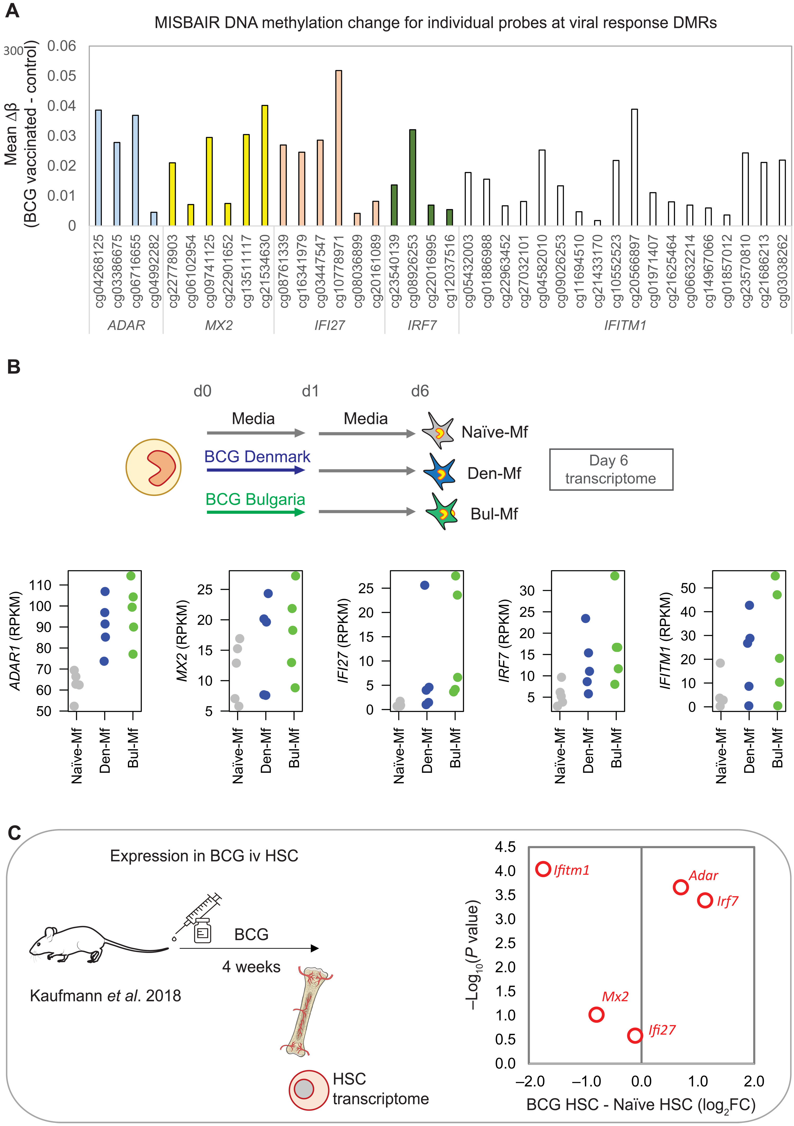
DMR analysis identifies 5 antiviral genes

Slide 17
All 5 genes more expressed in BCG-exposed monocytes
But are these regions differentially methylated? The data is available!

Slide 18
Mixed results in hematopoietic stem cells in vaccinated mice

Slide 19
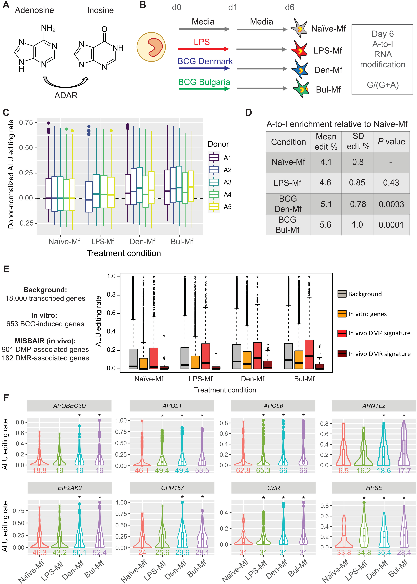
ADAR1 is 1 of the 5 genes … check if the higher ADAR1 expression in BCG-exposed cells is associated with higher rates of adenosine-to-inosine RNA editing
Yes, it does, at least at day 6 of macrophage differentiation

Slide 20
Check if BCG-association DNA methylation (from EWAS) is enriched in genes that undergo A-to-I RNA editing
A-to-I RNA edited genes = genes with evidence of editing at day 6 of macrophage differentiation)
Enrichment relative to background only for BCG-EWAS DMPs given genes edited in BCG-exposed macrophages

Slide 21
A-to-I RNA editing
Inosine (I) acts as guanosine (G) during translation
A-to-I RNA editing occurs in both coding and non-coding regions
Editing in coding regions leads to amino acid changes that may change protein function
Non-coding editing can lead to alternative splicing or influence small RNA regulation
Both the edited and unedited versions are often co-expressed in the same cell
A-to-I RNA editing may be applied to viral RNA
…

Slide 22
Conclusions
BCG exposure
Induces epigenetic changes that are long-lived (>1 year)
Trains cells
for response to viral infection
that requires IFNγ production
with potential for higher cytokine response
increases A-to-I RNA editing
But
Little overlap between BCG-associated DNAm in vitro (cells) vs in vivo (EWAS)
Mixed agreement with mouse model

Slide 23
Announcements

Slide 24
Would you like to teach this year?!
Epigenetic Epidemiology short course 8 - 10 May 2023
Advanced Epigenetic Epidemiology short course 18 - 19 May 2023
New! Machine learning module in the Medical Statistics and Data Science MSc programme Jan 26 – April 27 2023
Introduction to machine learning Machine learning algorithms Machine learning tools and environments Assessing performance (Valerio Maggio) Ethical issues (Helen Smith) Common challenges, pitfalls and limitations Interpreting black box models Automated causal inference

Slide 25
IEU meeting next week
Focus will be on the IEU Epigenetic Epidemiology programme

Slide 26
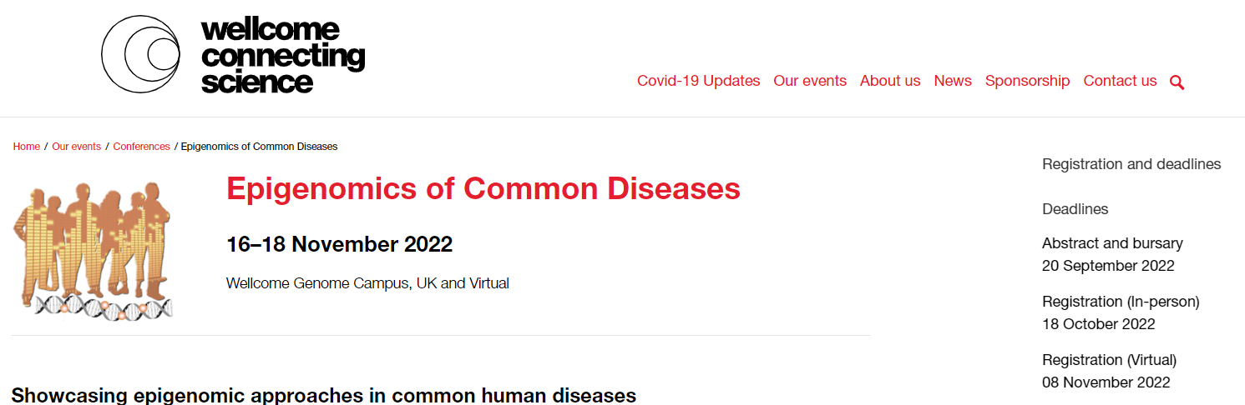
Special guest Francis Collins, Acting Science Advisor to the President of the United States and Former Director of the National Institutes of Health
Keynote speakers
Nada Jabado, McGill University, Canada
Dirk Schübeler, Friedrich Miescher Institute for Biomedical Research, Switzerland
Confirmed speakers Jacob Bergstedt, Elisabeth Binder, Liran Carmel, Rong Fan, Ariel Gershman, Amanda Fisher, Maja Jagodic, Christoph Kuppe, Rama Natarajan, Andrew Teschendorff

Slide 27
Research opportunities at Exeter
Doretta Caramaschi (Lecturer) has a 1-year postdoc position at Exeter
PhD project for the GW4 doctoral training partnership
The role of prenatal inflammation on neurodevelopmental disorders MRC GW4 BioMed DTP PhD studentship 2023/24 Entry- PhD in Psychology Ref: 4526
Supervisors: Doretta Caramaschi, Emma Dempster, Josine Min, Matthew Suderman
https://www.exeter.ac.uk/study/funding/award/?id=4526

